Slide 1
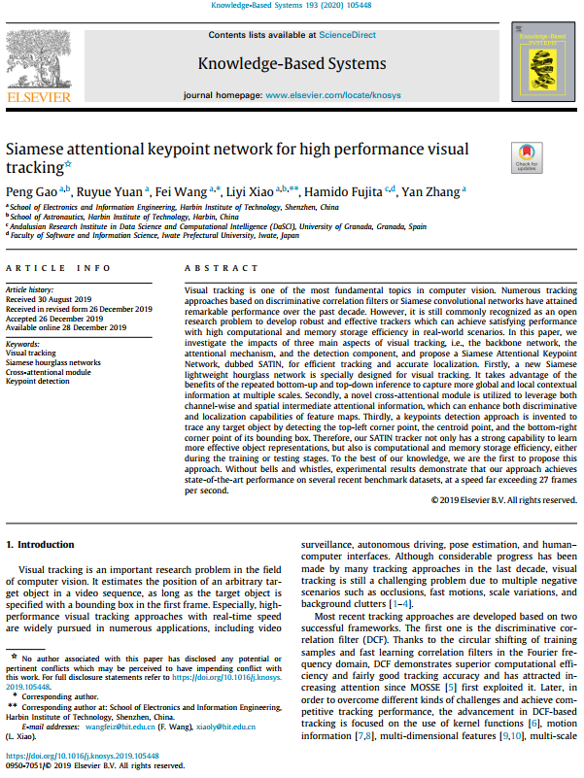
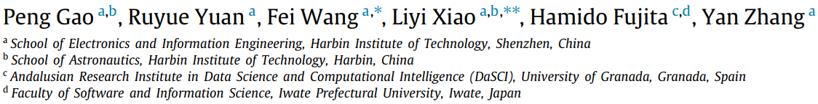
Seminar presentation (05th November 2020)
Siamese attentional keypoint network for high performance visual tracking
Published in ELSEVIER
Knowledge-Based Systems (2020)
Presented by:
Md. Maklachur Rahman
Virtual Reality Lab School of Computer Science and Engineering
Kyungpook National University
Republic of Korea

Slide 2
Main contributions
The contribution of the proposed method has three folds:
They introduce a new Siamese lightweight hourglass network for visual tracking to acquire the full advantage of bottom-up and top-down inference for capturing more global and local contextual information at multiple scales.
A novel cross-attentional module is utilized by incorporating channel and spatial attentional information, which can enhance both discriminative and localization capabilities of feature maps.
A keypoint detection approach is invented to trace any target object by detecting the top-left corner point, the centroid point, and the bottom-right corner point of its bounding box.

Slide 3
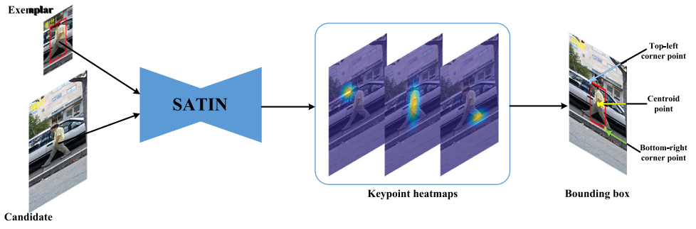
Tracker framework
Fig. 1. Visualization of heatmaps of SATIN. Tracking result on the 200th frame of the sequence David3 is presented, with the top-left corner point, the centroid point and the bottom-right corner point marked.

Slide 4
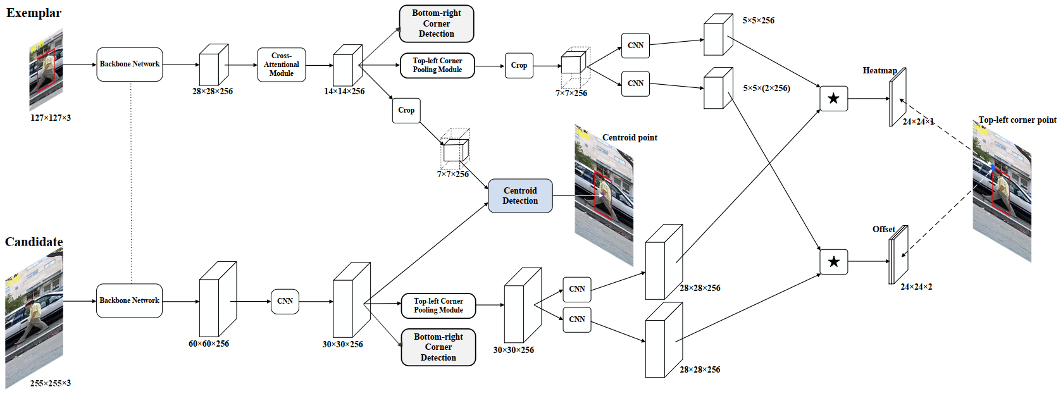
Tracker framework (continue)
Fig. 2. The overall framework of the proposed framework (SATIN). For the sake of clarity, we only show pipelines of the top-left corner (bottom-right corner) point and the centroid point detection.

Slide 5
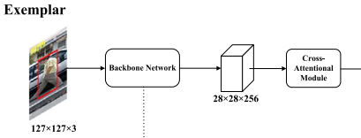
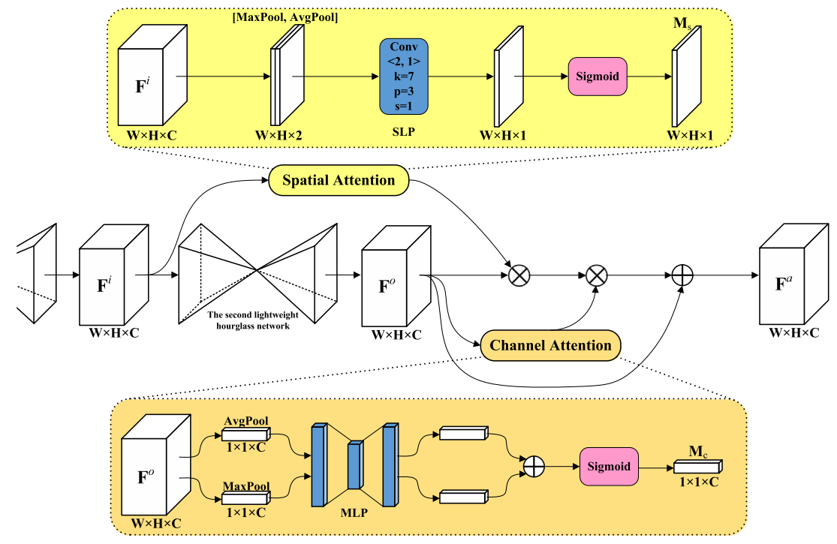
Cross-attentional module

Slide 6
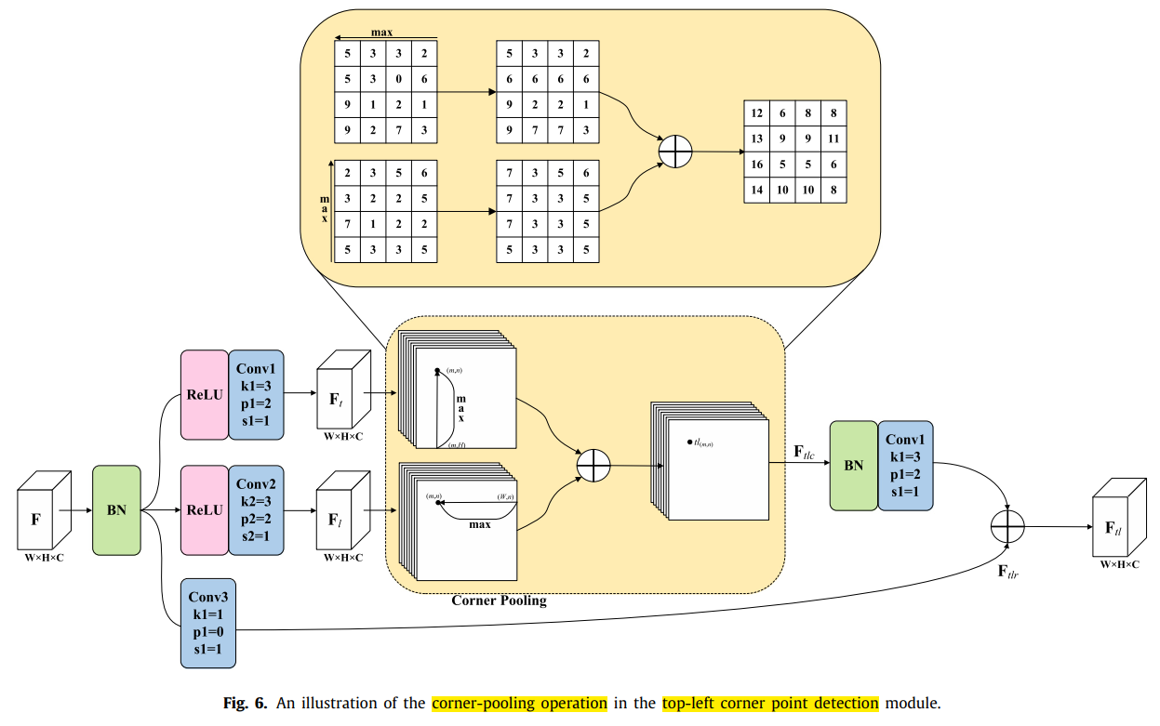
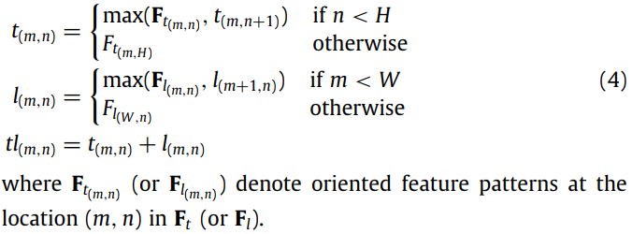
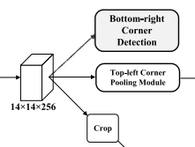
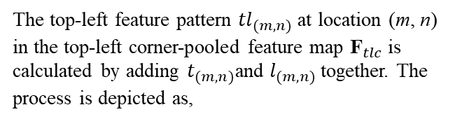
Corner pooling module
The top-left feature pattern ${tl}_{(m,n)}$ at location (m, n) in the top-left corner-pooled feature map ${\text{F}}_{tlc}$is calculated by adding $t_{(m,n)}$and $l_{(m,n)}$together. The process is depicted as,

Slide 7
Tracker framework (continue)
Fig. 2. The overall framework of the proposed framework (SATIN). For the sake of clarity, we only show pipelines of the top-left corner (bottom-right corner) point and the centroid point detection.

Slide 8
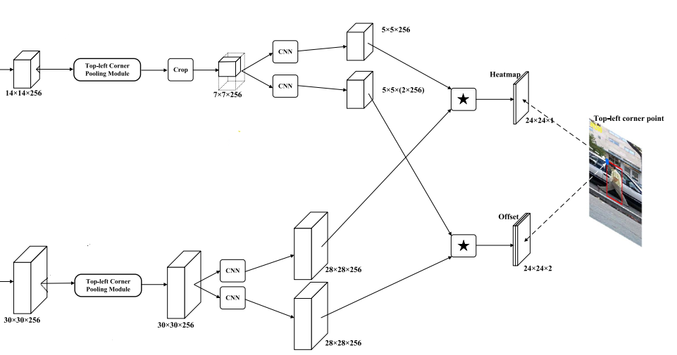
Tracker framework (continue)
Fig. 2.1. The top-left corner point detection network.

Slide 9
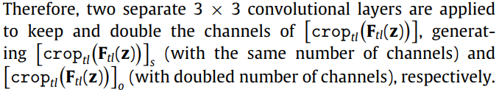


Response map calculation
Since, the outputs are a single-channel heatmap for prediction and a double-channel offset map for refinement.

Slide 10
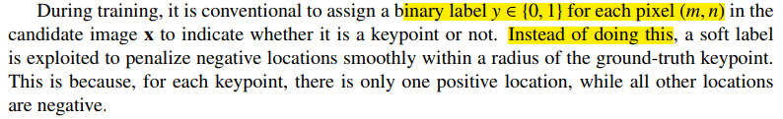
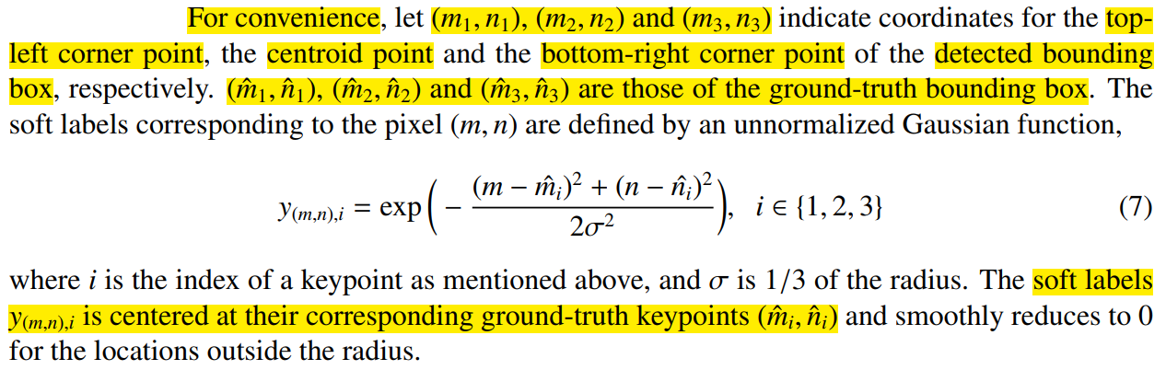
Ground-Truth label computation

Slide 11
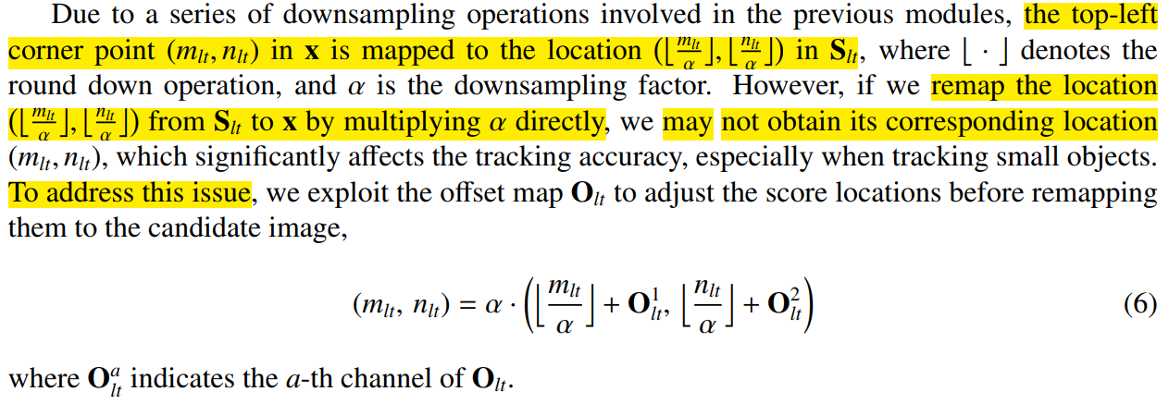
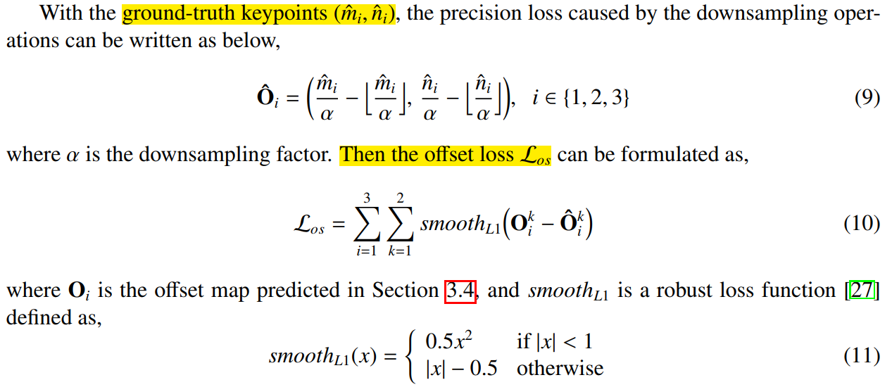
Loss calculation (continue)

Slide 12
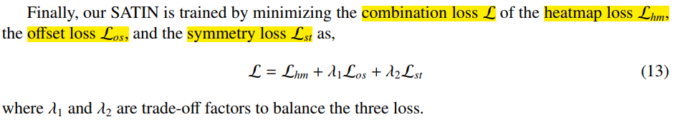
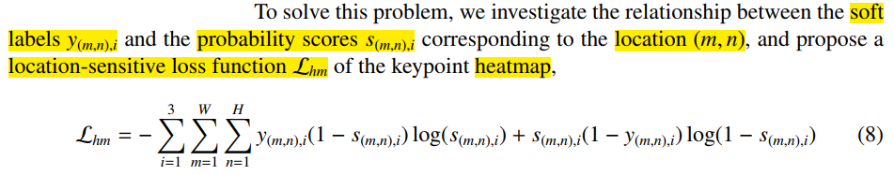
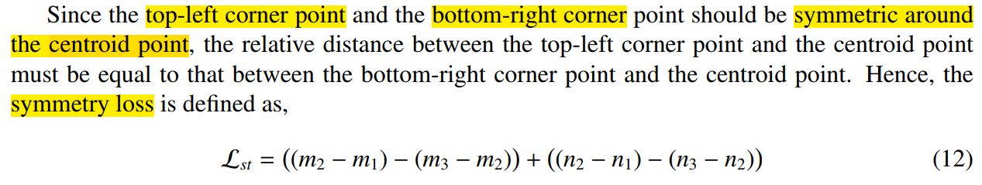
Loss calculation (continue)

Slide 13
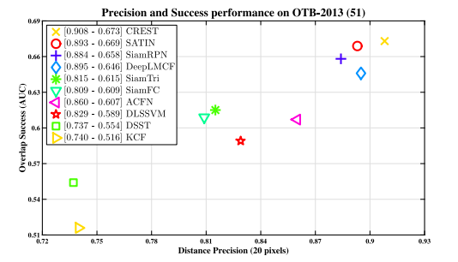
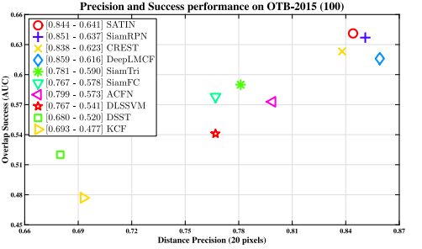
Experimental results on OTB2013 and OTB 2015 benchmarks
Fig. 7 and 8. Success and precision performance on the OTB-2013 and OTB-2015 benchmarks. The first number in the legend indicates the AUC score while the second denotes DP score at error threshold of 20 pixels. The best trackers are located at the top-right corner.

Slide 14
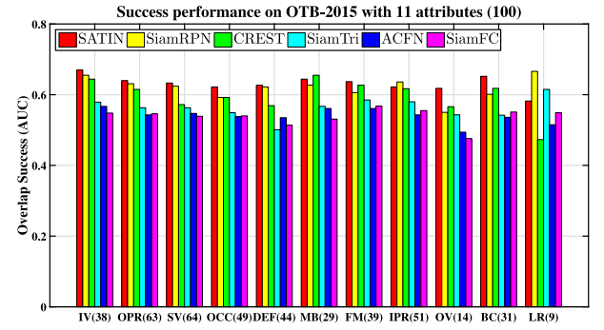
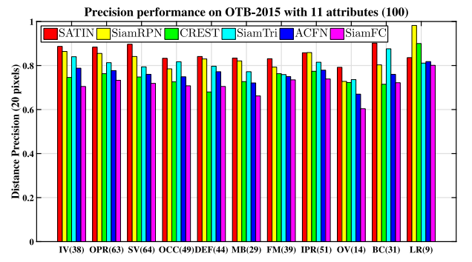
Experimental results on OTB 2015 benchmark (challenges)
Fig. 9 and 10. Success and precision performance on the OTB-2015 benchmark with 11 attributes [44]. Best viewed in color.

Slide 15
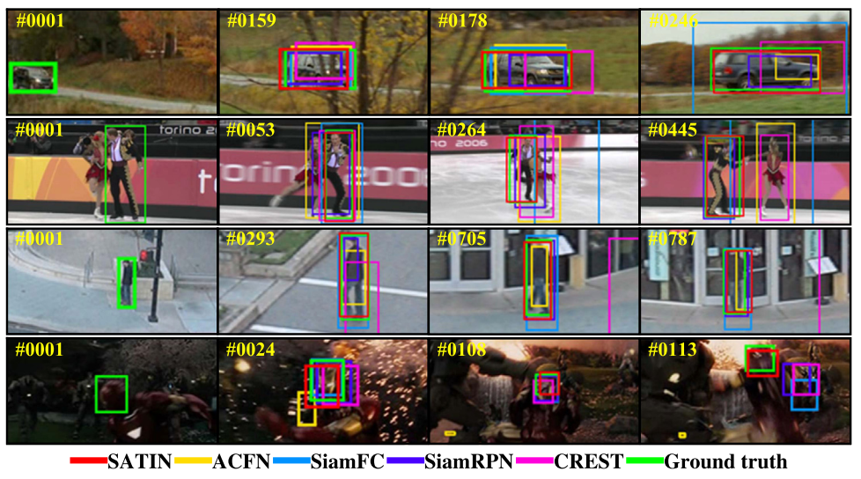
Experimental results on OTB 2015 benchmark (qualitative analysis)
Fig. 11. Example tracking results of STAIN with the comparison to state-of-the-are trackers including ACFN [60], SiamFC [21], SiamRPN [25] and CREST [61] on four challenging sequences (from top to down: carScale, Skating2-2, Human6 and ironman). The ground-truth are illustrated with green bounding boxes. Best viewed in color.

Slide 16
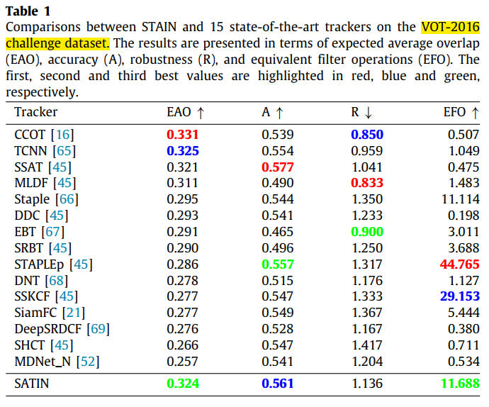
Experimental results on VOT2016 benchmark

Slide 17
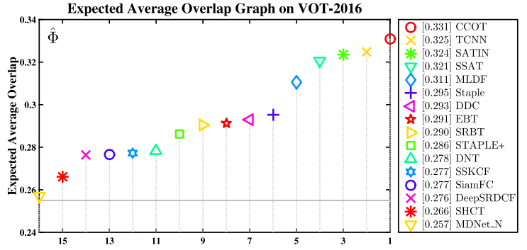
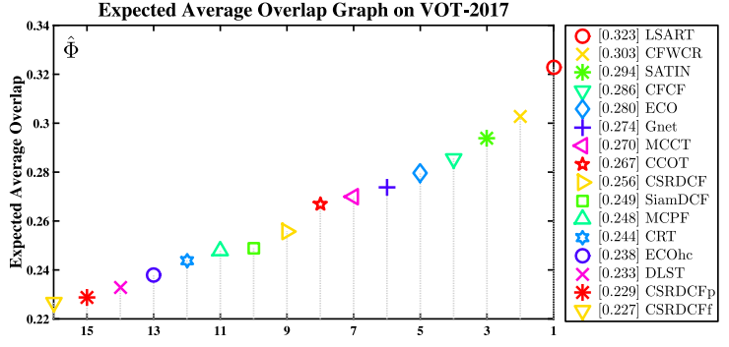
Experimental results on VOT2016 benchmark (continue)
Fig. 12 and 13. Expected average overlap graph with trackers ranked on the VOT-2016 challenge dataset [45]. For presentation clarity, only the top 16 trackers with respect to the EAO score are shown in the plot. The better trackers are located at the right.

Slide 18
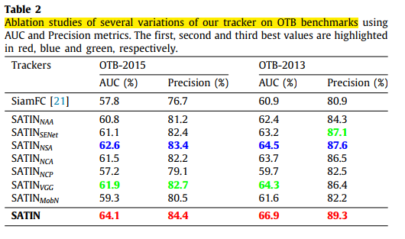
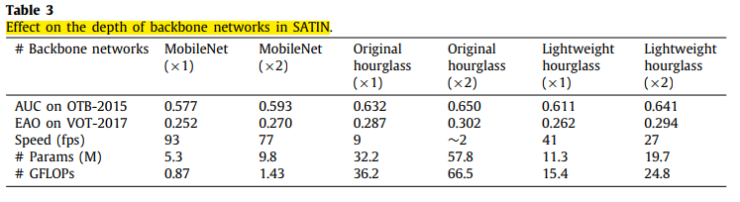
Ablation study

Slide 19
Conclusion
This method uses a novel corner detection mechanism for visual object tracking.
They utilize siamese lightweight hourglass network as the backbone network to capture more global and local contextual information.
It achieves state-of-the-art performance and can run at 27 fps.

Slide 20
감사합니다 (Thank you) Q&A

